Slide 1
Architecture Merit Badge
Troop 344 and 9344
Pemberville, OH

Slide 2
Architecture Merit Badge Requirements
Do the following:
Tour your community and list the different building types you see. Try to identify buildings that can be associated with a specific period of history or style of architecture. Make a sketch of the building you most admire.
Select an architectural achievement that has had a major impact on society. Using resources such as the Internet (with your parent's permission), books, and magazines, find out how this achievement has influenced the world today. Tell your counselor what you learned.

Slide 3
Architecture Merit Badge Requirements
In the Outdoor Code, a Scout pledges to "be conservation-minded." Discuss the following with your counselor:
The term sustainable architecture. Identify three features typical of green buildings.
The difference between renewable building materials and recycled building materials, and how each can be used in construction.
The relationship of architecture with its surrounding environment and the community.
How entire buildings can be reused rather than torn down when they no longer serve their original purpose.

Slide 4
Architecture Merit Badge Requirements
Do ONE of the following:
With your parent's and counselor's permission and approval, arrange to meet with an architect. Ask to see the scale model of a building and the drawings that a builder would use to construct this building. Discuss why the different building materials were selected. Look at the details in the drawings and the scale model to see how the materials and components are attached to each other during construction.

Slide 5
Architecture Merit Badge Requirements
Do ONE of the following:
With your parent's and counselor's permission and approval, arrange to meet with an architect at a construction site. Ask the architect to bring drawings that the builder uses to construct the building. While at the site, discuss why the different building materials being used were selected. Discuss how the different building materials and components are attached to each other during construction. Note: To visit a construction site will require advance planning. You will need permission from your parents, counselor, the architect, and the construction site manager. A construction site is a very dangerous place. While there, you will need to closely follow the site manager's directions and comply with all the safety procedures, including wearing a hard hat protective eyewear, and proper footwear. Be aware of the changing conditions at the site, and stay with the architect or site manager.

Slide 6
Architecture Merit Badge Requirements
Do ONE of the following:
Interview someone who might be your client (such as a prospective homeowner or business owner) if you were an architect. Find out what your client's requirements would be for designing a new home or business building. Write a short program including a list of requirements for the project, the functions of the building and site, hoe the functions relate to one another, and the goals of the project.

Slide 7
Architecture Merit Badge Requirements
Measure a room such as one where you live or where your troop meets. Make an accurately scaled drawing of the room's floor plan showing walls, doors, closets, windows, and any built-in furniture or cabinets. Neatly label your drawing with the following: your name, the date, what room you drew, and the scale of the drawing. (Drawing scale: 1/4 inch = 1 foot)
Find out about three career opportunities in architecture. Pick one and find out the education, training, and experience required for this profession. Discuss this with your counselor, and explain why this profession might interest you.

Slide 8
Requirement 1
Do the following:
Tour your community and list the different building types you see. Try to identify buildings that can be associated with a specific period of history or style of architecture. Make a sketch of the building you most admire.

Slide 9
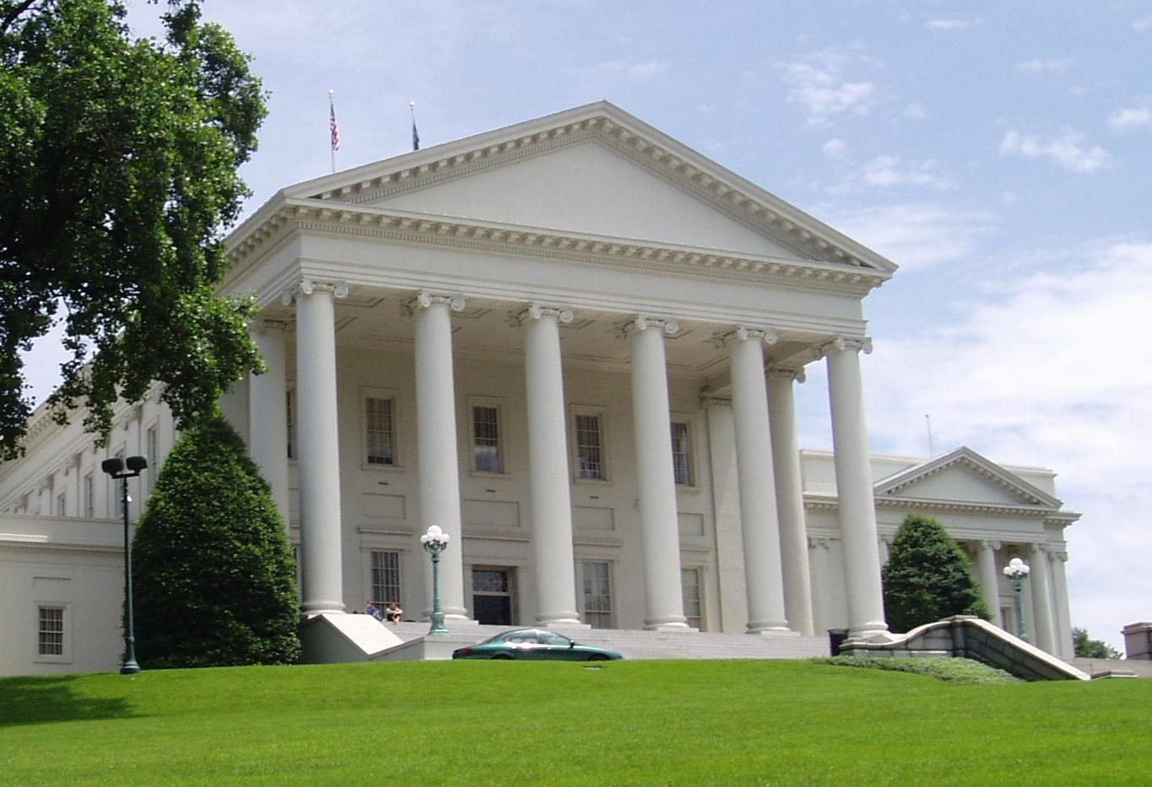
Classical Architecture
Classical architecture usually denotes architecture which is derived from the principles of Greek and Roman architecture of classical antiquity.
The fronts of ancient Roman temples like the Maison Carrée in Nîmes have inspired much later classical architecture, e.g. Virginia State Capitol.

Slide 10
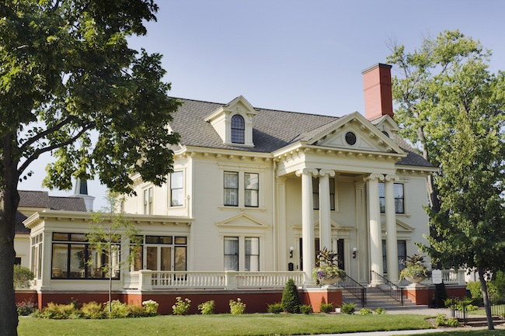
Classical Architecture
Defining Features of a Classical Home:
Front porch topped with a pediment. Many homes and buildings feature a full-height front porch that is set with a classical pediment at the top. The door is usually positioned at the center of the house.
Durable building materials. Classical architecture incorporates materials like marble, concrete, and brick.
Classical design motifs. Homes often have dental molding, medium pitched roofs, boxed eaves, decorative door surrounds, and broken pediments over the entry door.
Rectangular windows. Windows were often double-hung and included a variety of symmetrical window configurations.

Slide 11
Neoclassical Architecture
Neoclassical architecture describes buildings that are inspired by the classic architecture of ancient Greece and Rome.
In the United States, it describes the important public buildings built after the American Revolution, well into the 1800s.
The U.S. Capitol in Washington, D.C. is a good example of neoclassicism, a design chosen by the Founding Fathers in 1793.

Slide 12
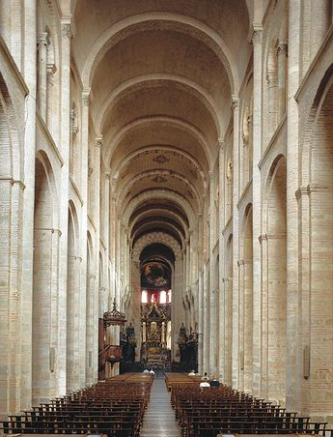
Romanesque Architecture
Romanesque architecture is known by its massive quality, thick walls, round arches, sturdy pillars, barrel vaults, large towers and decorative arcading, and a very regular, symmetrical plan.

Slide 13
Gothic Architecture
Gothic architecture featured exaggerated pointed arches, increased vaulting, and enlarged windows.
Gothic architects employed flying buttresses for support.
These stone structures allowed architects to create sky-high cathedrals and churches that evoked ethereality and reached toward the heavens.

Slide 14
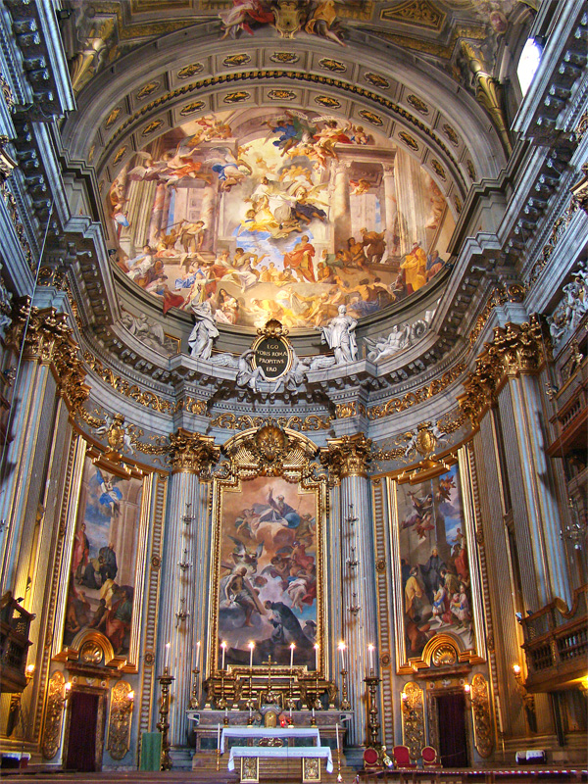
Baroque Architecture
Baroque architecture is a highly decorative and theatrical style which appeared in Italy in the early 17th century and gradually spread across Europe.
Baroque architects took the basic elements of Renaissance architecture, including domes and colonnades, and made them higher, grander, more decorated, and more dramatic.
Church of Saint Ignatius of Loyola
Rome, Italy

Slide 15
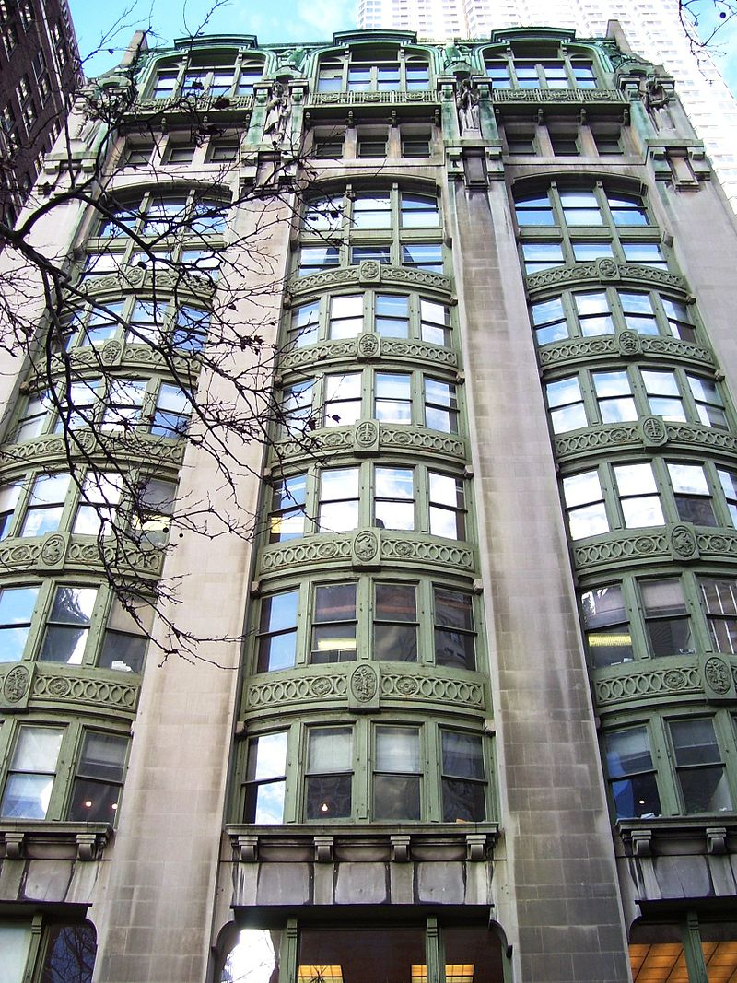
Art Nouveau Architecture
Art Nouveau was an international style in architecture and design that emerged in the late 19th century.
It flourished mostly between 1890-1910 in Europe and the United States.
It was often inspired by natural forms such as the sinuous curves of plants and flowers.
Other characteristics of Art Nouveau were the use of modern materials, particularly iron, glass, ceramics and later concrete, to create unusual forms and larger open spaces.
New York Evening Post Building, NYC

Slide 16
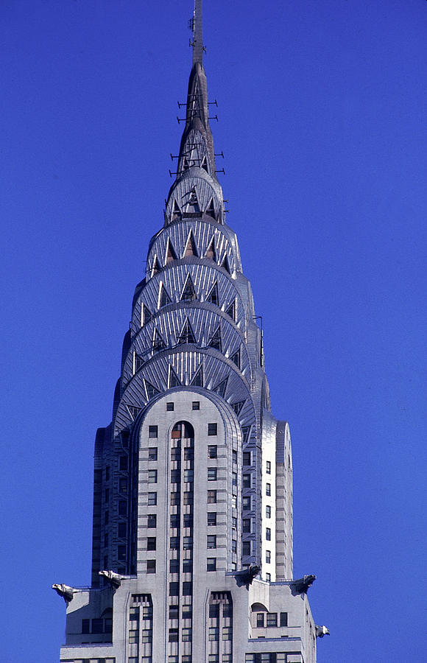
Art Deco Architecture
Art Deco originated in the 1920s and developed into a major style in western Europe and the United States during the 1930s.
Characteristics:
Art Deco buildings utilized materials like stucco, terracotta, decorative glass, chrome, steel, and aluminum.
Various motifs and ornamental details were applied to a building. Some common Art Deco motifs include chevrons, pyramids, stylized sunbursts or florals, zig-zags, and other geometric shapes.
Buildings incorporated stark colors like black and white or gold and silver to create contrast.
Many facades were created using vertical lines that were angular and pointed in an upward and outward direction. These triangular shapes were capped off with a series of steps that eventually come to a point.
Windows and doors were decorated with geometric designs. The windows were often positioned in a long, horizontal row.
Corners of buildings were often decorated with tower-like structures that would make a simple square building seem more opulent.
Chrysler Building, NYC

Slide 17
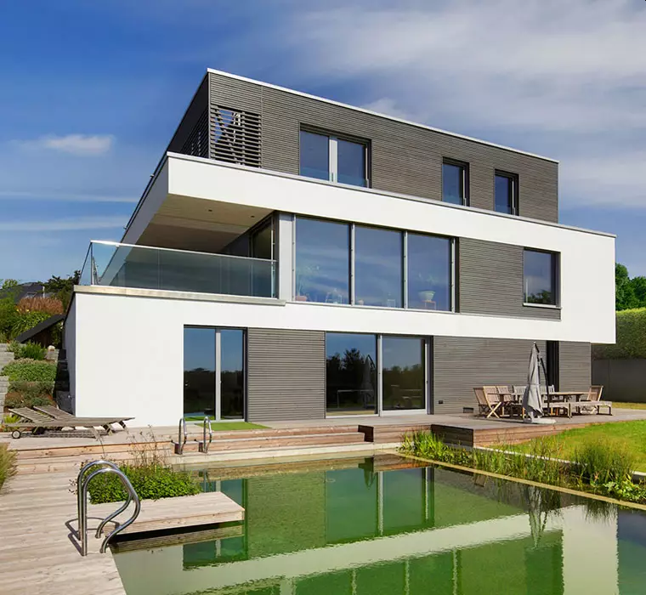
Bauhaus Architecture
Characteristics of Bauhaus Architecture:
Focus on simple, rational, functional design
A focus on simple geometric forms such as the triangle, square, and circle
Asymmetry favored over symmetry
Use of steel, glass, concrete, and other modern materials
Flat roofs
Glass curtain walls
Smooth façades

Slide 18
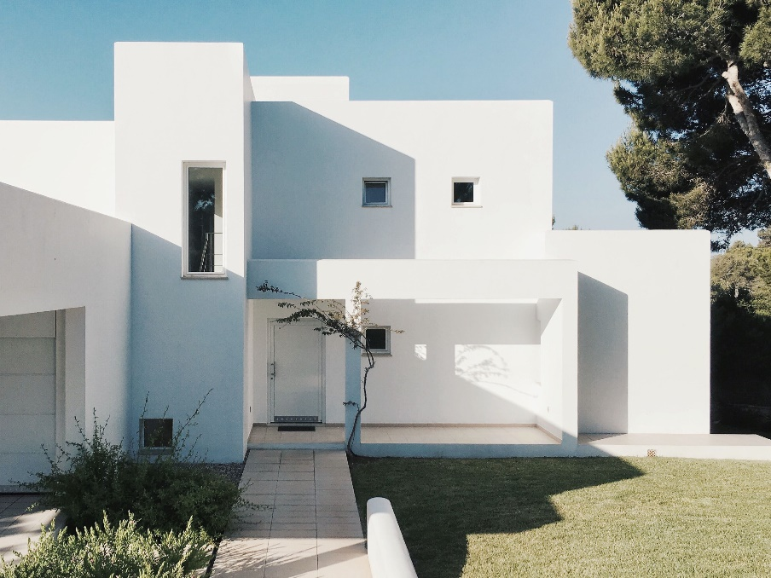
Modern Architecture
Characteristics of Modern Architecture:
Lack of ornament: Decorative moldings and elaborate trim are eliminated or greatly simplified, giving way to a clean aesthetic where materials meet in simple, well-executed joints.
Emphasis of rectangular forms and horizontal and vertical lines: Shapes of houses are based boxes, or linked boxes.

Slide 19
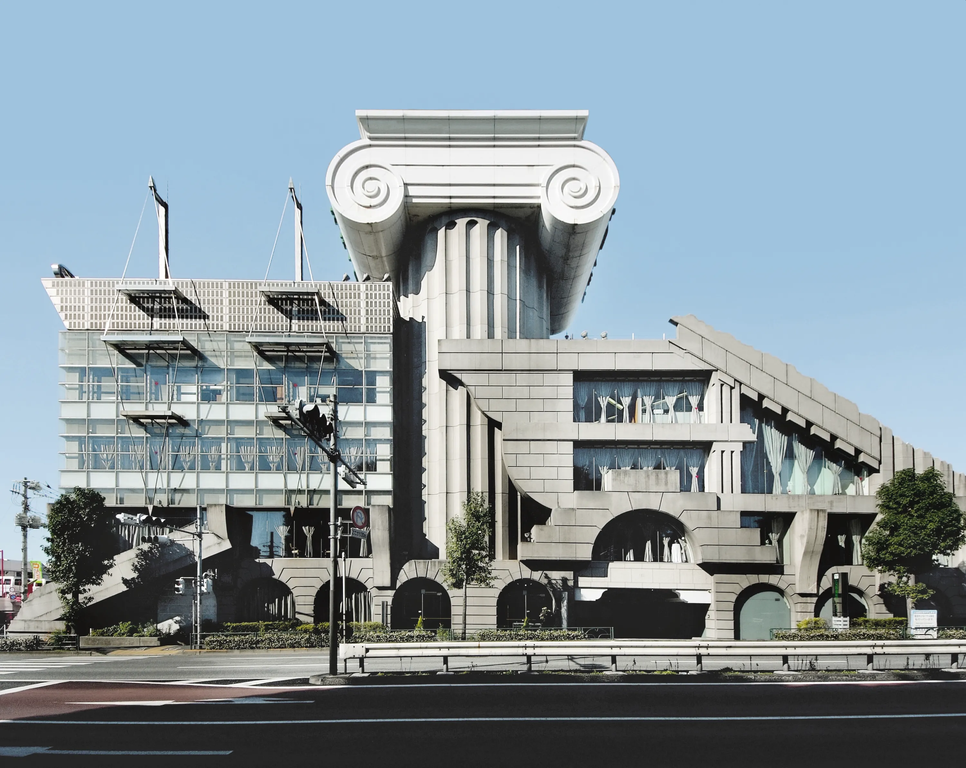
Post Modern Architecture
Characteristics Of Postmodern Architecture And Design:
Typically, colored glass, ceramic tiles and stones are used on exterior surfaces
Texture plays a key role in making Postmodern architectural structures unique.
Asymmetry is an important element of Postmodern design.
Postmodern style uses “camp” humor – meaning something that’s so bad, it’s actually good (i.e. a building that appears like it’s about to collapse, but it was strategically designed to look that way).

Slide 20
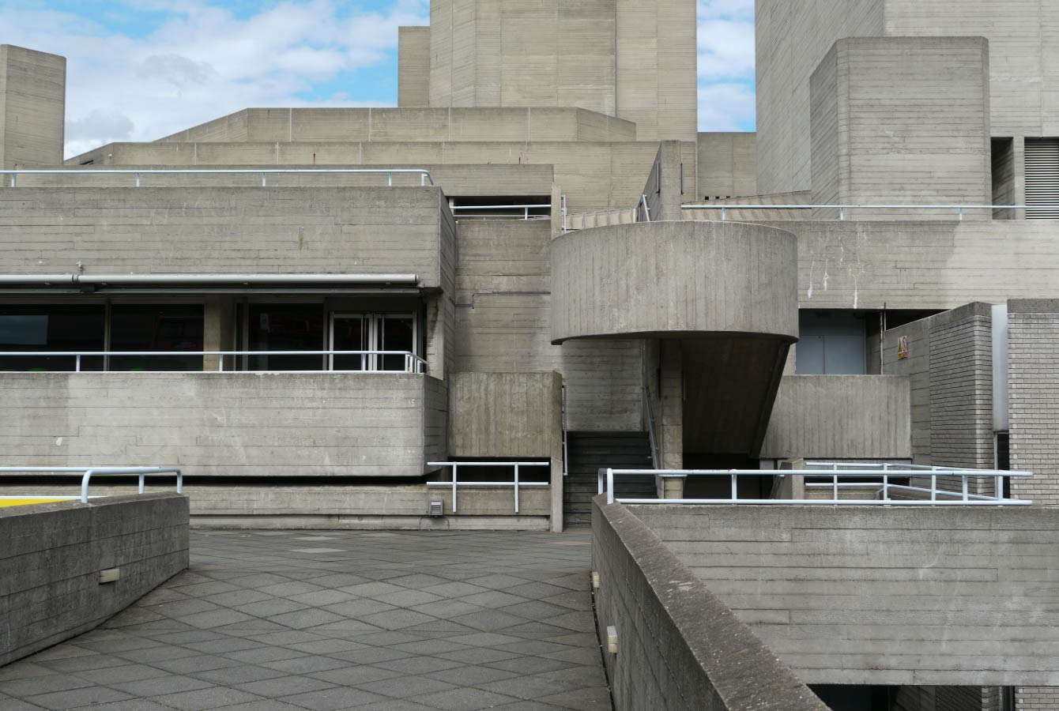
Brutalist Architecture
Characteristics of Brutalist Architecture:
Typical features included unadorned, flat, usually concrete, exteriors that are rarely finished.
It also includes unusual shapes, straight lines, and small windows.
Modular elements were often used to form masses representing specific functional zones, grouped into a unified whole.

Slide 21
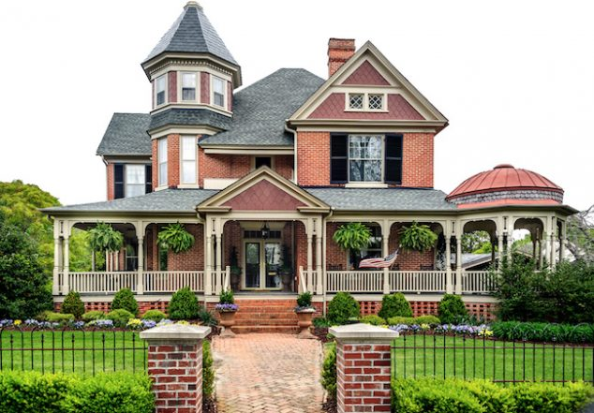
Victorian Architecture Types
Defining Features of a Victorian Home:
Steeply pitched roofs.
Plain or colorfully painted brick.
Ornate gables.
Painted iron railings.
Churchlike rooftop finials.
Sliding sash and canted bay windows.
Octagonal or round towers and turrets to draw the eye upward.
Two to three stories.

Slide 22
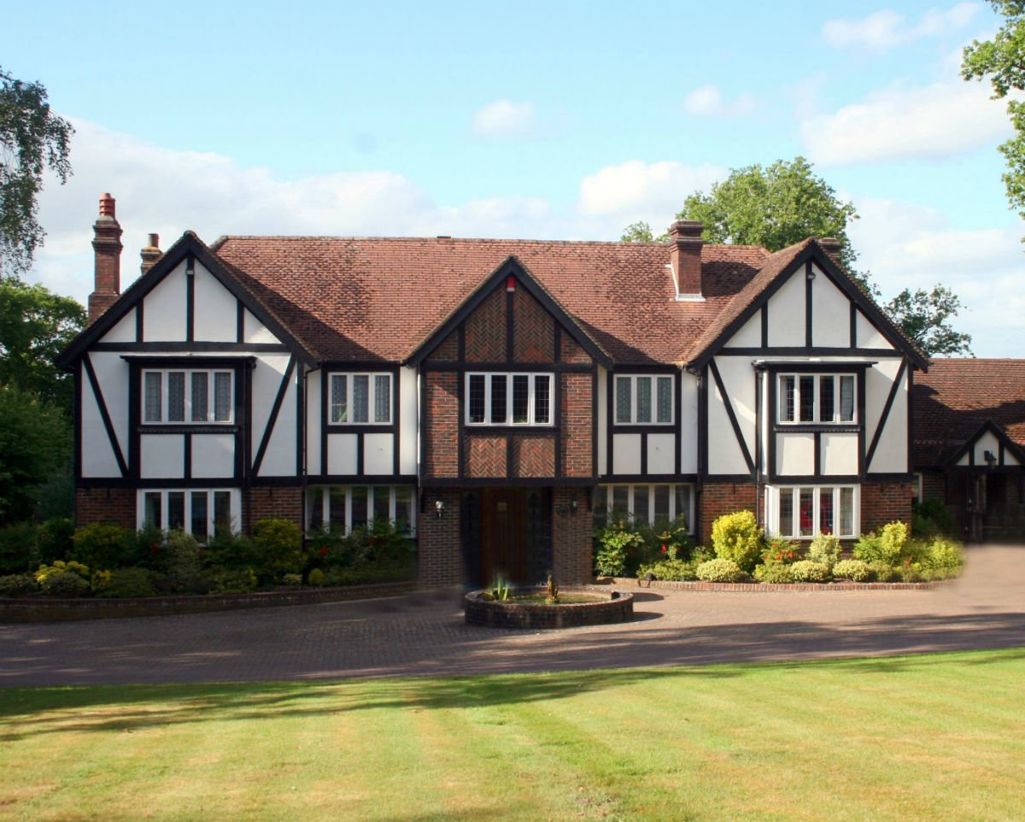
Tudor Architecture Types
Defining Features of a Tudor Home:
Steeply pitched gable roofs.
Elaborate masonry chimneys.
Embellished doorways.
Groupings of windows.
Decorative half-timbering (this last an exposed wood framework with the spaces between the timbers filled with masonry or stucco).

Slide 23
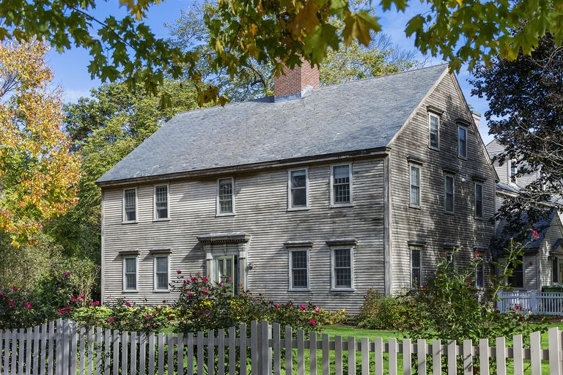
Colonial Architecture
Defining Features of a Colonial Home:
Symmetrical front and rectangular shape.
Two stories.
Side gabled, steep roof with narrow eaves.
Little exterior ornamentation.
Casement windows.
Massive central chimney.
Made of wood and covered with clapboard or shingles.

Slide 24
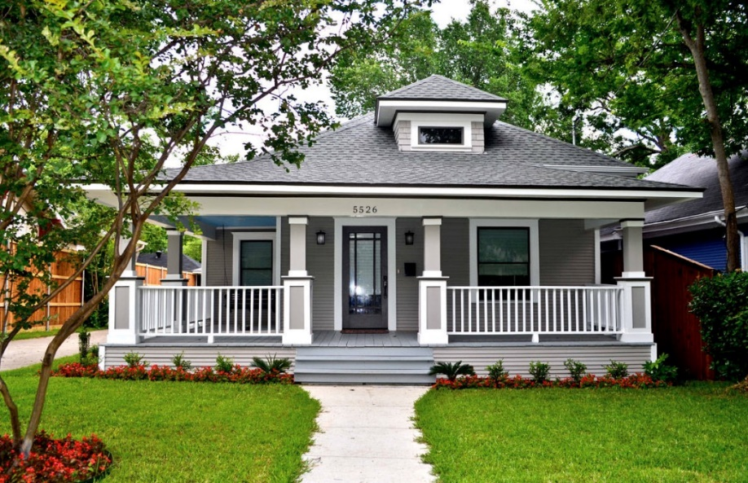
Craftsman Architecture
Defining Features of a Craftsman Home:
Low-pitched rooflines, usually done in a hip or gable (triangular) style.
Wide, overhanging eaves.
Exposed rafters under the eaves.
A covered front porch.
Pillars lining the entry.
Double hanging windows, which have separate panes of glass on the top and bottom.
Single, protruding dormers.

Slide 25
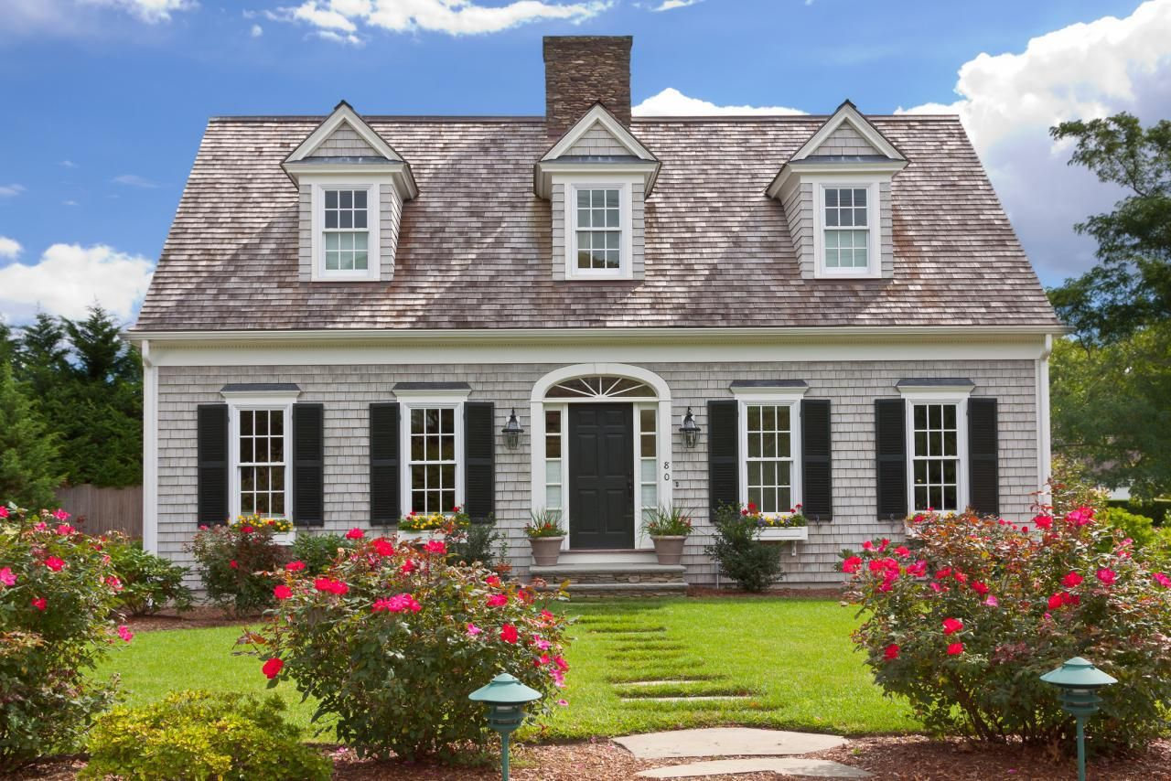
Cape Cod Architecture
Defining Features of a Cape Cod Home:
Symmetrical appearance with a centered front entry.
Steep roofs with side gables and an overhang.
Shingle siding.
Gabled dormers.
Double-hung windows with shutters.
Centralized chimneys.
Simple exterior ornamentation.

Slide 26
Requirement 1
Do the following:
Select an architectural achievement that has had a major impact on society. Using resources such as the Internet (with your parent's permission), books, and magazines, find out how this achievement has influenced the world today. Tell your counselor what you learned.

Slide 27
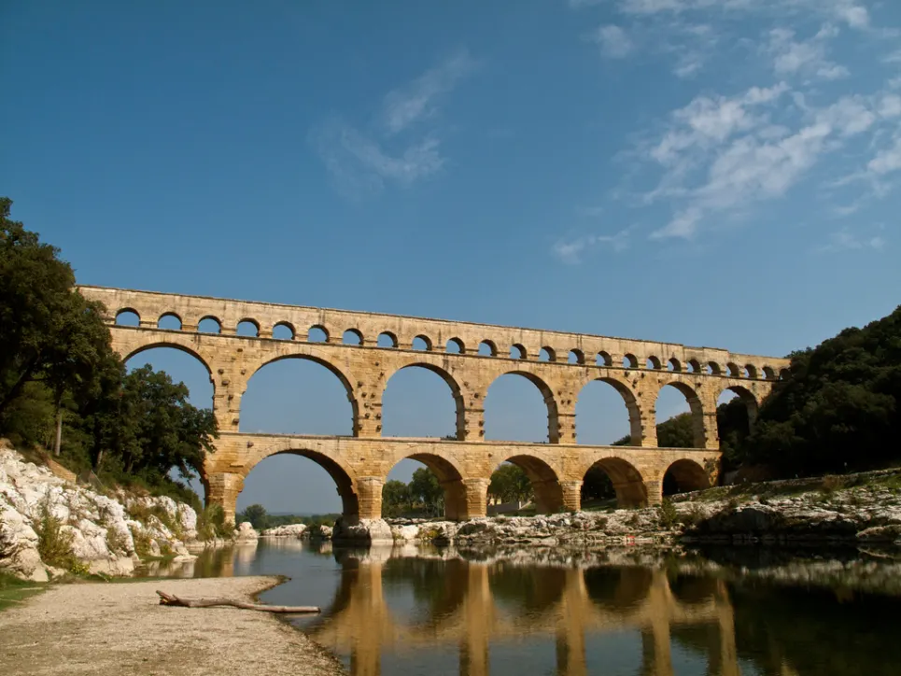
Architectural Achievements
Rounded arches were invented by the Mesopotamians 4,000 years ago, but were popularized by ancient Romans, who relied heavily on the arch in a lot of their monumental architecture.
The best-known examples are aqueducts.
The load-bearing arch has been widely used and transformed into many different shapes throughout the past 2,000 years.

Slide 28
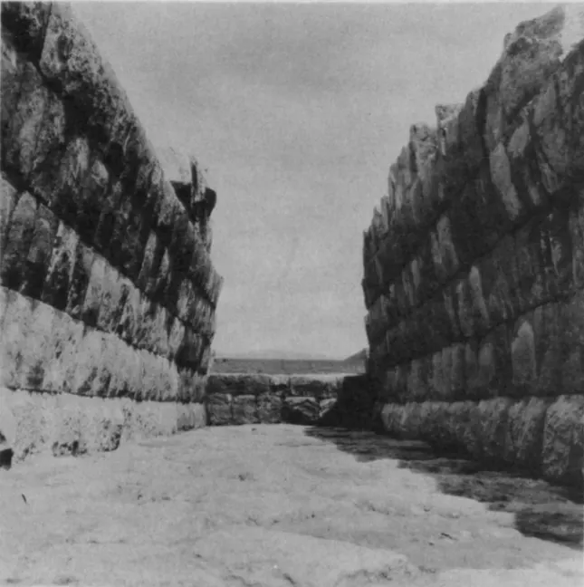
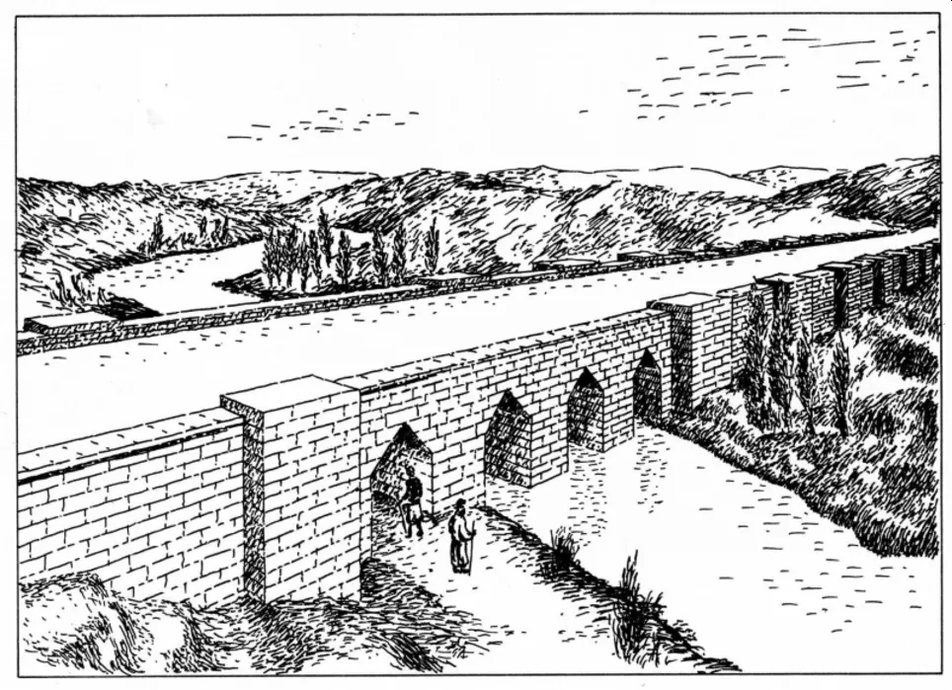
Architectural Achievements
The Assyrian Jerwan Aqueduct, built between 703 and 688 BC. It used fully waterproof concrete, an incredible innovation that allowed people to build massive structures in water.

Slide 29
Architectural Achievements
Glass windows were first used by the Ancient Romans in Alexandria around 100 AD.

Slide 30
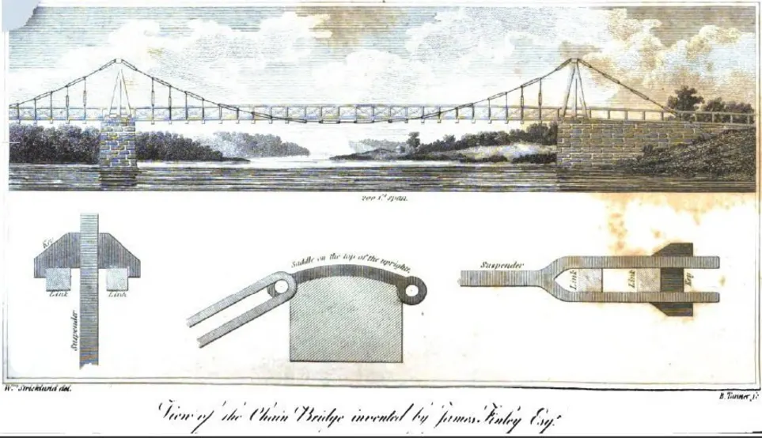
Architectural Achievements
The first wire-cable suspension bridge, the 407 ft. (124 m) long Spider Bridge at Falls of Schuylkill in Philadelphia, Pennsylvania, constructed by Erskine Hazard & Josiah White, opened in 1816.

Slide 31
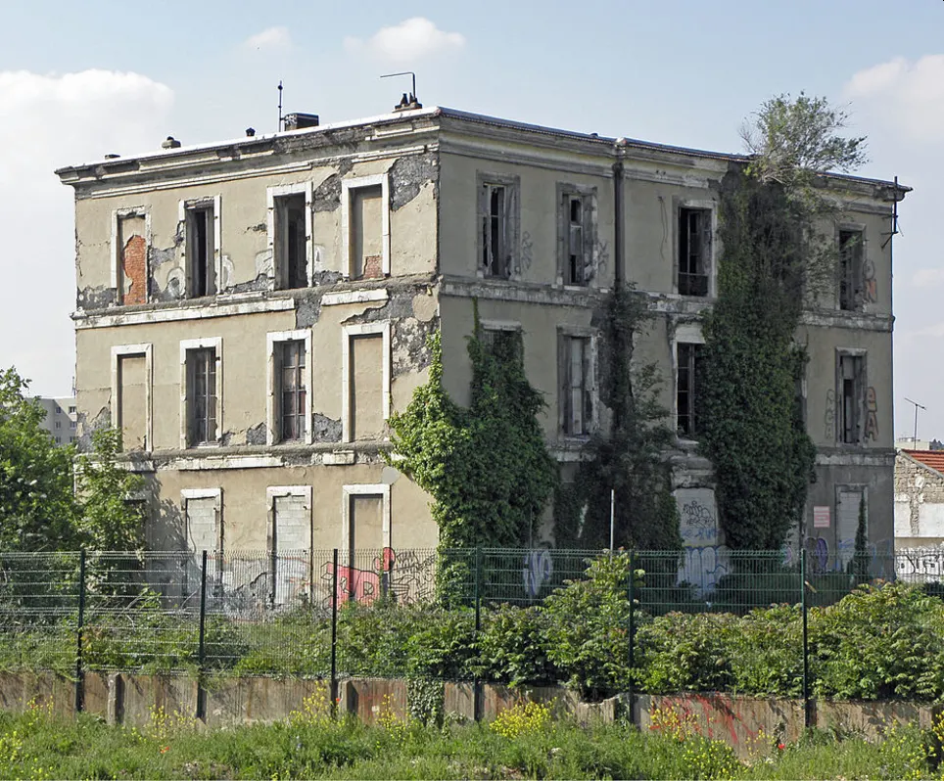
Architectural Achievements
In 1853, the first iron-reinforced concrete structure, a four-story house in the northern suburbs of Paris, France, designed by Theodore Lachez, was built by François Coignet.

Slide 32
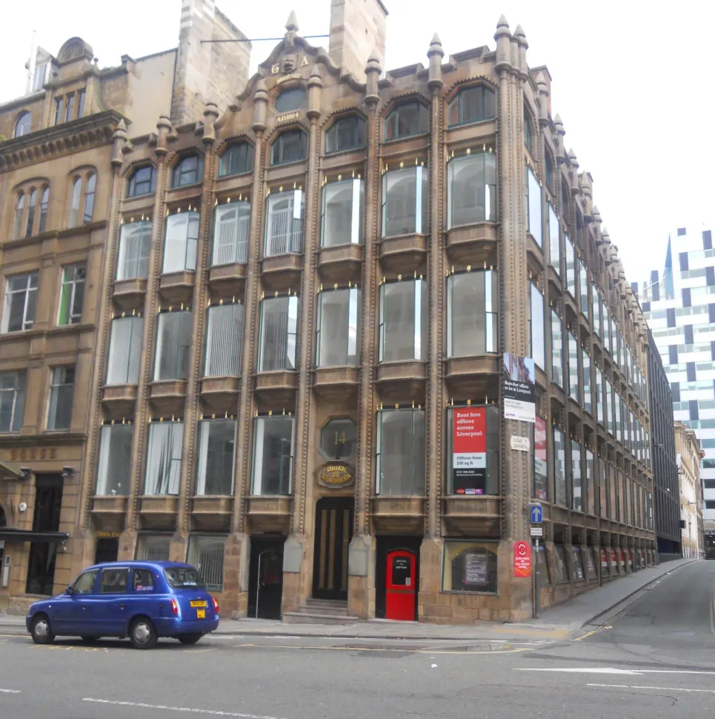
Architectural Achievements
The world's first iron-framed, glass curtain-walled building, the Oriel Chambers in Liverpool, England, designed by Peter Ellis in 1864.

Slide 33
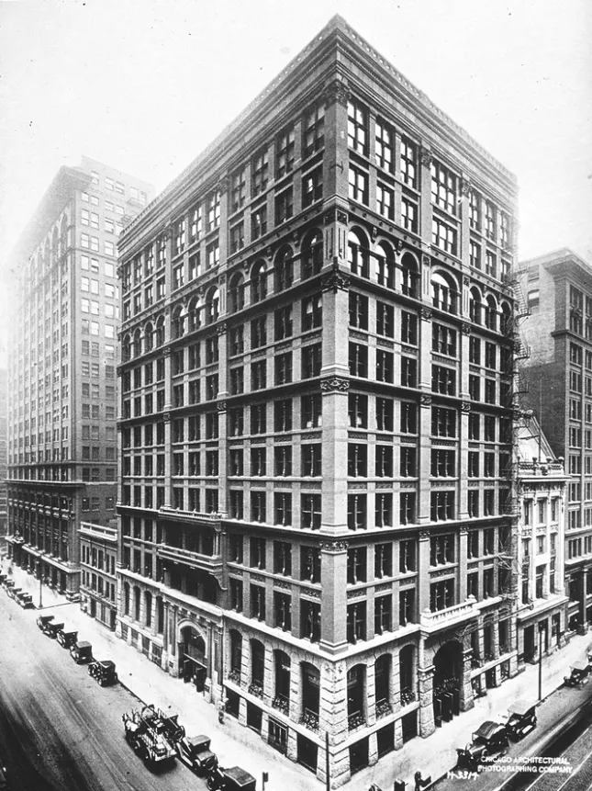
Architectural Achievements
The 138 ft. (42 m) high Home Insurance Building in Chicago, the first skyscraper and the first to use structural steel in its frame, designed by William Le Baron Jenney, completed in 1884.

Slide 34
Requirement 2
In the Outdoor Code, a Scout pledges to "be conservation-minded." Discuss the following with your counselor:
The term sustainable architecture. Identify three features typical of green buildings.

Slide 35
Sustainable Architecture
Sustainable architecture is a general term that refers to buildings that are designed to limit humanity’s impact on the environment.
An eco-friendly approach to modern day building encompasses every aspect of the planning and construction process.
This includes the choice of building materials; the design and implementation of heating, cooling, plumbing, waste, and ventilation systems; and the integration of the built environment into the natural landscape.
Oasia Hotel Downtown in Singapore

Slide 36
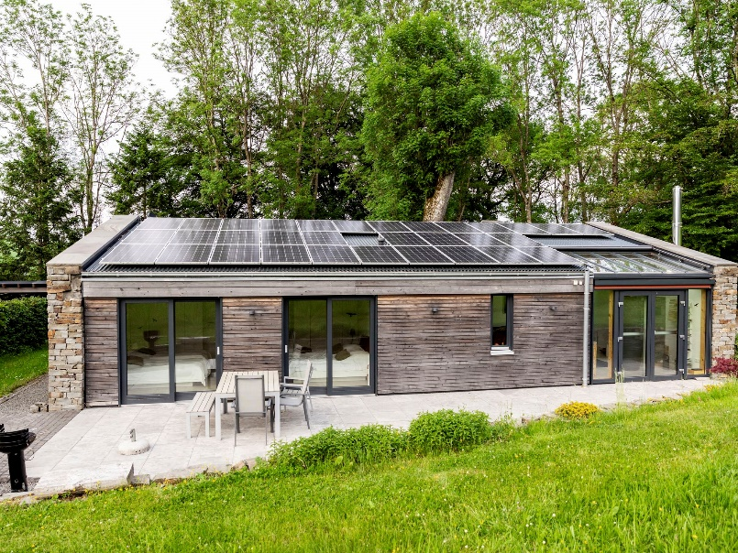
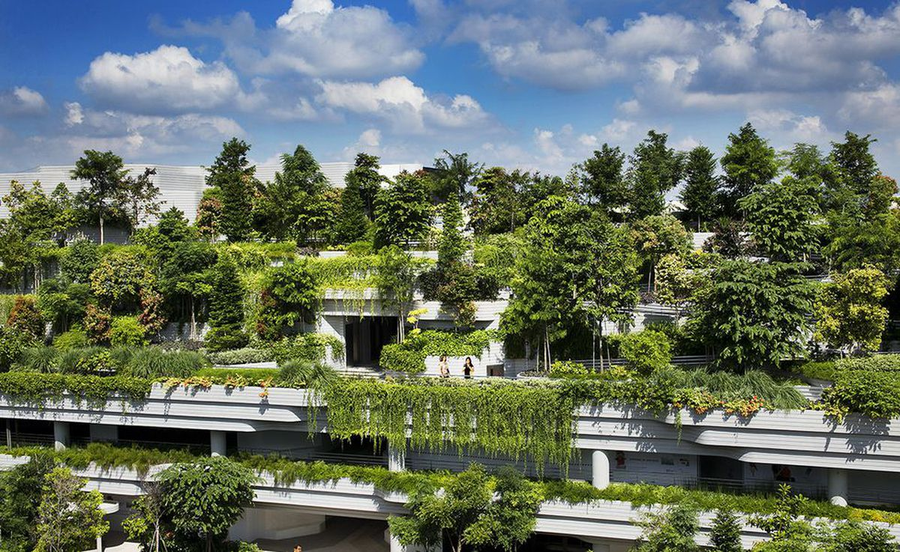
Sustainable Architecture
Characteristics of Sustainable Architecture
Overall focus on reducing human environmental impact on the environment
Limiting wasteful energy consumption with the use of renewable energy sources such as solar panels and natural heating, cooling, and ventilation systems
Buildings that produce at least as much energy as they consume for a net zero effect
Water conservation systems such as rainwater collection and recycling gray water
Green roofs, living walls for natural cooling and the health and well being of people who work and live inside
Integration into the surrounding landscape
Use of renewable materials such as bamboo, hemp, cork, flax, and soy.

Slide 37
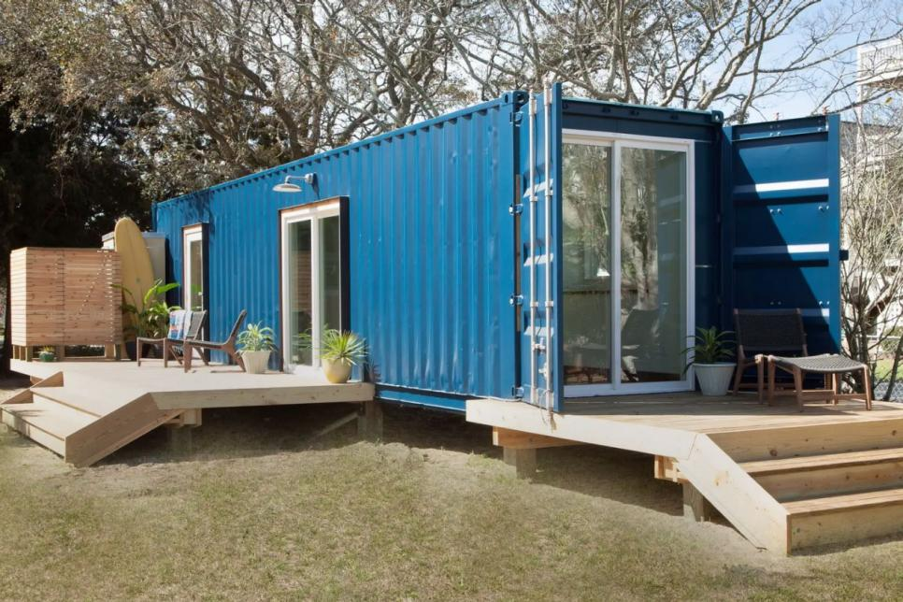
Sustainable Architecture
Characteristics of Sustainable Architecture (continued)
Replacing conventional materials such as concrete with sustainable alternatives such as hempcrete made from hemp, lime, and water.
Use of recycled and upcycled materials
Adaptable, modular spaces made from natural materials that can be easily broken down and repurposed or recycled.
Tiny houses, micro apartments and other small structures that use less land mass and energy.
Alternative housing solutions such as homes and apartment buildings constructed from recycled shipping containers.
Incorporation of plants and nature via living walls and green roofs to help cool existing buildings and create healthy environments for humans.

Slide 38
Features of Green Buildings
A “green” building is a building that, in its design, construction or operation, reduces or eliminates negative impacts, and can create positive impacts, on our climate and natural environment.
Green buildings preserve precious natural resources and improve our quality of life.
There are a number of features which can make a building ‘green’. These include:
Efficient use of energy, water and other resources
Use of renewable energy, such as solar energy
Pollution and waste reduction measures, and the enabling of re-use and recycling
Good indoor environmental air quality
Use of materials that are non-toxic, ethical and sustainable
Consideration of the environment in design, construction and operation
Consideration of the quality of life of occupants in design, construction and operation
A design that enables adaptation to a changing environment

Slide 39
Features of Green Buildings

Slide 40
Requirement 2
In the Outdoor Code, a Scout pledges to "be conservation-minded." Discuss the following with your counselor:
The difference between renewable building materials and recycled building materials, and how each can be used in construction.

Slide 41
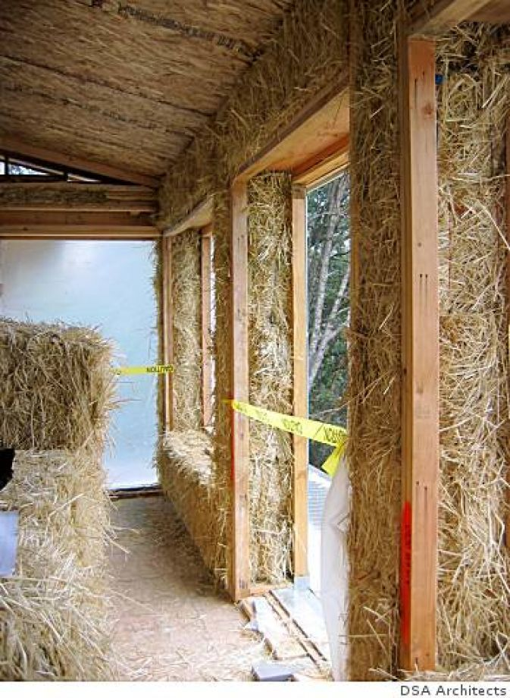
Renewable Building Materials
Renewable building materials use resources that have the capability to be naturally and organically replaced in a set time period.
Examples include:
Bamboo
Straw bales
Reclaimed lumber
Sheep wool

Slide 42
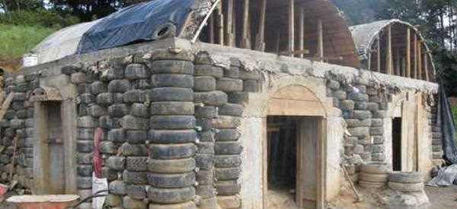
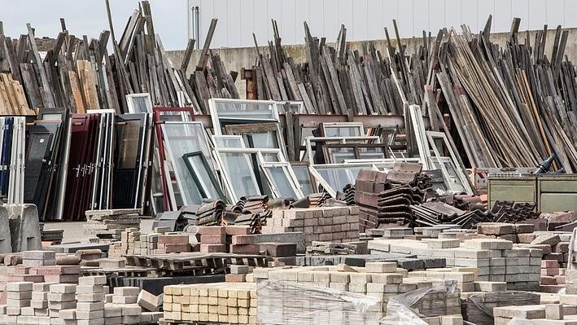
Recycled Building Materials
Recycled building materials are from waste products being transformed into new supplies and products.

Slide 43
Requirement 2
In the Outdoor Code, a Scout pledges to "be conservation-minded." Discuss the following with your counselor:
The relationship of architecture with its surrounding environment and the community.

Slide 44
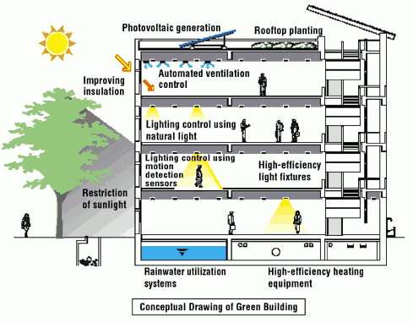
Architecture and Environment
Architects need to make buildings that are friendly to the environment by taking into consideration:
Efficiently using energy, water, and other resources
Protecting residents’ health and improving people’s productivity
Reducing waste, pollution, and environmental degradation

Slide 45
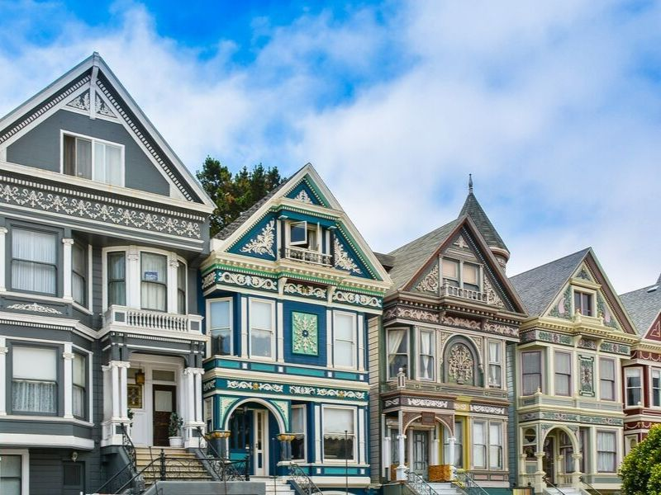
Architecture and Community
Architects need to consider the social aspect in buildings by preserving cultural heritage, educating the local community, as well as promote safety and health.

Slide 46
Requirement 2
In the Outdoor Code, a Scout pledges to "be conservation-minded." Discuss the following with your counselor:
How entire buildings can be reused rather than torn down when they no longer serve their original purpose.

Slide 47
Repurposing Buildings
Adaptive Reuse refers to the process of reusing an existing building for a purpose other than which it was originally built or designed for.
Old buildings physically link us to our past and become a part of our cultural heritage and should be preserved because of their "architectural beauty" and the "character and scale they add to the built environment".
Retention and rehabilitation of existing buildings also reduces the consumption of building materials, resources, energy and water needed for new construction.

Slide 48
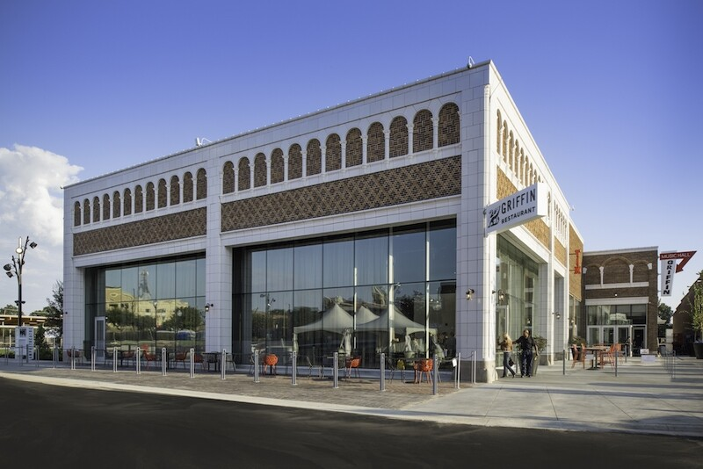
Adaptive Reuse

Slide 49
Requirement 3
Do ONE of the following:
With your parent's and counselor's permission and approval, arrange to meet with an architect. Ask to see the scale model of a building and the drawings that a builder would use to construct this building. Discuss why the different building materials were selected. Look at the details in the drawings and the scale model to see how the materials and components are attached to each other during construction.

Slide 50
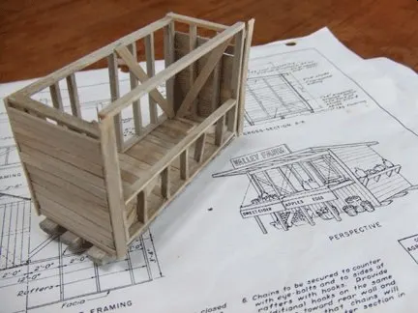
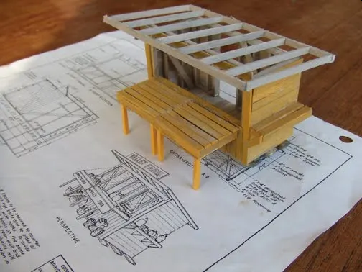
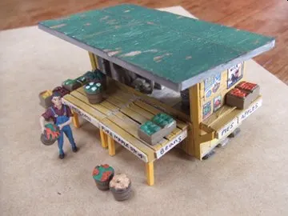
Scale Model of Building

Slide 51
Requirement 3
Do ONE of the following:
With your parent's and counselor's permission and approval, arrange to meet with an architect at a construction site. Ask the architect to bring drawings that the builder uses to construct the building. While at the site, discuss why the different building materials being used were selected. Discuss how the different building materials and components are attached to each other during construction.

Slide 52
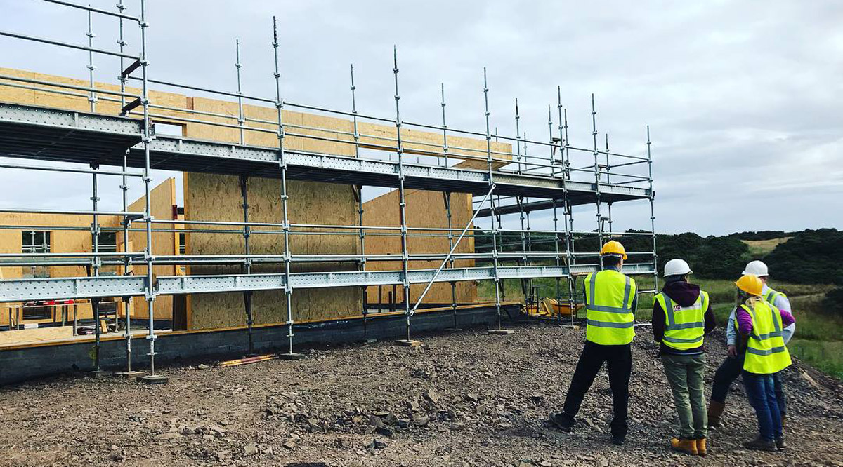
Construction Site
Note: To visit a construction site will require advance planning.
You will need permission from your parents, counselor, the architect, and the construction site manager.
A construction site is a very dangerous place.
While there, you will need to closely follow the site manager's directions and comply with all the safety procedures, including wearing a hard hat protective eyewear, and proper footwear.
Be aware of the changing conditions at the site, and stay with the architect or site manager.

Slide 53
Requirement 3
Do ONE of the following:
Interview someone who might be your client (such as a prospective homeowner or business owner) if you were an architect. Find out what your client's requirements would be for designing a new home or business building. Write a short program including a list of requirements for the project, the functions of the building and site, how the functions relate to one another, and the goals of the project.

Slide 54
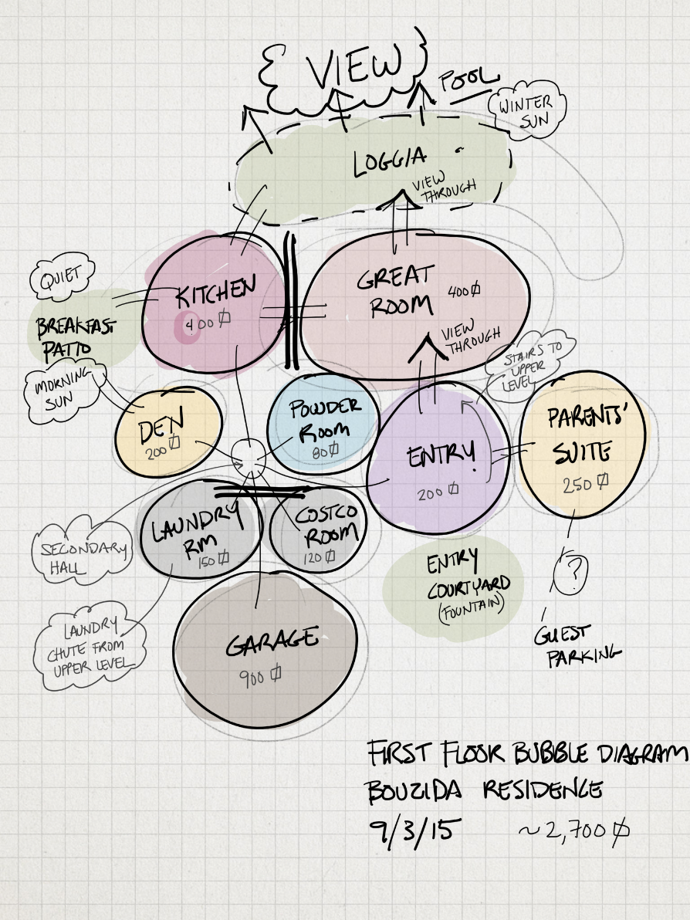
Programming Phase of Design
The programming phase is where the project is built—not brick by brick, but decision by decision.
The first step in the programming phase is for problem-seeking.
You will mainly ask your client questions to gain an understanding of their problems, wants, and needs.

Slide 55
Programming Process
Establish goals and objectives
Here are some questions you can ask in this early design phase:
How should the form and image of the building impact the users and surrounding areas?
What will be the main and side uses of the building?
What is the budget and is it firm?
When do they want the building to be occupied?
Are there any restrictions or requirements that will impact the design process?

Slide 56
Programming Process (continued)
Gather relevant information
Use good questions to gain a very clear understanding of every space in the building and the client’s wants and needs. Take your time with this step – the more questions you ask now, the more accurate the programming phase will be.
The questions should be both quantitative, e.g. how big should the space be, and qualitative, e.g. how should the space feel and look.
If the client has an existing building that serves the same purpose, use that as a springboard to nail down what the client wants and doesn’t want.
Listen to the client complain about all the issues with their current master bathroom. People often have a stronger idea of what they don’t like than what they do like.
Identify strategies
Now that you know how each room will be used, you can look at how those spaces fit together. Continue to get the owner’s input at this stage of the design phase.
Just because you think you know how the spaces should fit and flow together, doesn’t mean that is how the owner wants or needs it.

Slide 57
Requirement 4
Measure a room such as one where you live or where your troop meets. Make an accurately scaled drawing of the room's floor plan showing walls, doors, closets, windows, and any built-in furniture or cabinets. Neatly label your drawing with the following: your name, the date, what room you drew, and the scale of the drawing. (Drawing scale: 1/4 inch = 1 foot)

Slide 58
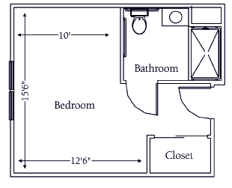
How to Draw a Floor Plan to Scale
Sketching a rough outline on paper can be useful for planning a room arrangement, but taking the time to draw a floor plan to scale is often worth the extra effort.
Scale floor plans aid the design process and can really help you visualize things, such as the ideal furniture layout.
Creating a floor plan to scale can be as simple as taking accurate measurements with a tape measure, then using a pencil and graph paper to scale down your results.

Slide 59
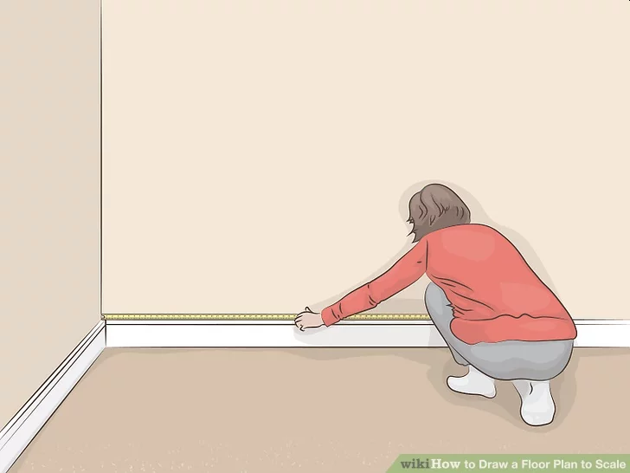
Scaled Drawing of Floor Plan
Take corner to corner wall measurements around the room.
Run a tape measure from corner to corner on top of the baseboard (if there is one) or along the floor (if there isn’t a baseboard).
If there are many obstructions (furniture, etc.) against the walls, you can instead use a stepladder and measure along the ceiling.
It’s easier to work with a helper (to hold the end of the tape), especially in a larger room or when you need precise measurements.

Slide 60
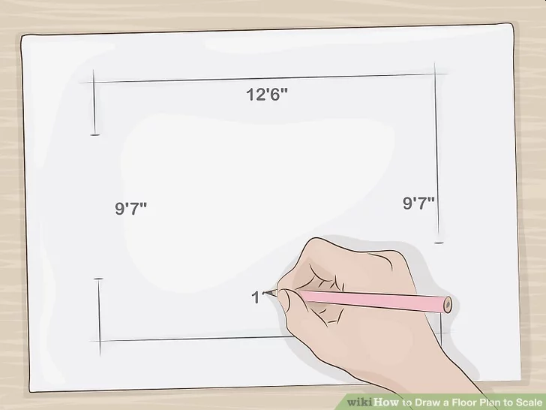
Scaled Drawing of Floor Plan
Add the room measurements to a rough sketch of the room.
Skip the ruler or graph paper and feel free to just use a pencil and blank paper.
If you’re measuring a basic rectangular room, simply jot down your 4 measurements next to the corresponding walls.
If the room has bump-outs for a closet, an angled corner, etc., add those measurements as well in the appropriate spot.
Write down feet/inches measurements in the form 11’ 6” or 10’ 3¼”.

Slide 61
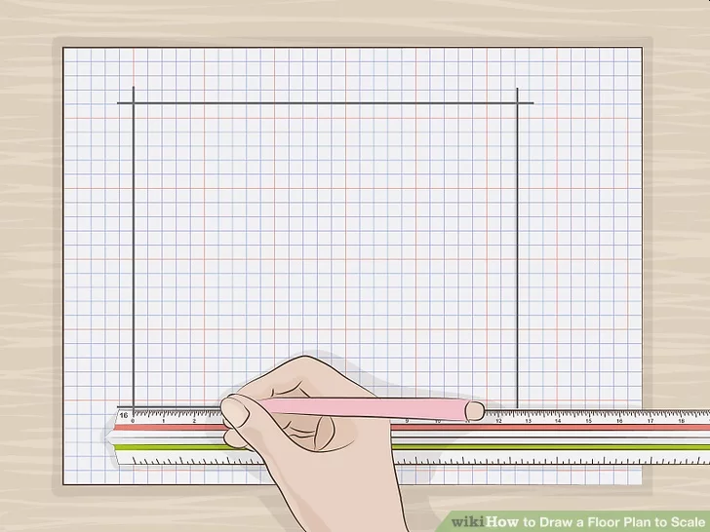
Scaled Drawing of Floor Plan
Convert your measurements with a scale ruler for precision.
A scale ruler (or architect’s scale) looks like a triangular-shaped ruler and can adjust measurements to your preferred scale quickly.
The different sides of the scale are marked with different common scale ratios—for instance, ¼” = 1’, which is common for architectural drawings.
Once you find the side with your preferred ratio, simply do the following: Lay that side of the ruler on your paper.
Draw a line on the paper between the zero mark on the ruler and the number mark on the ruler that matches the length of the wall you’re drawing (e.g. 11’).
The line will automatically be at a ¼” = 1’ scale, meaning it will be 2 ¾” long to represent an 11’ long wall.

Slide 62
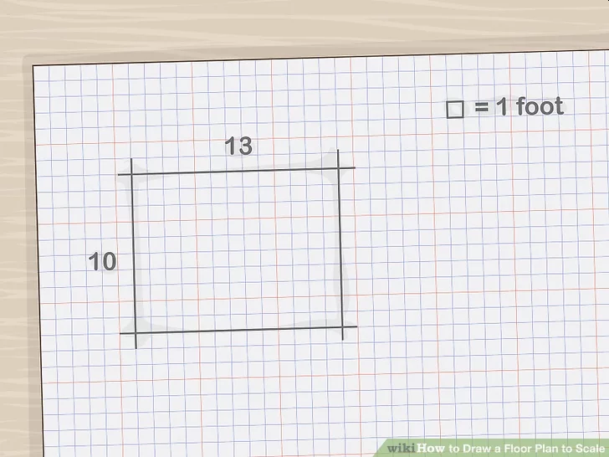
Scaled Drawing of Floor Plan
Use a “one square equals one foot” scale on graph paper for simplicity.
If you don't have a scale ruler, a typical 8 in × 10.5 in (20 cm × 27 cm) sheet of graph paper with a grid of .25 in (0.64 cm) squares will work just fine.
At this size, you’ll find approximately 41 squares running along the long side of the paper, and 31 squares on the short side.
So as long as the room isn't bigger than 40 ft × 30 ft (12.2 m × 9.1 m)), a single square can represent one square foot.
This ¼” = 1’ scale (also represented by the ratio 1:48) is very common in architectural measurements in the U.S.

Slide 63
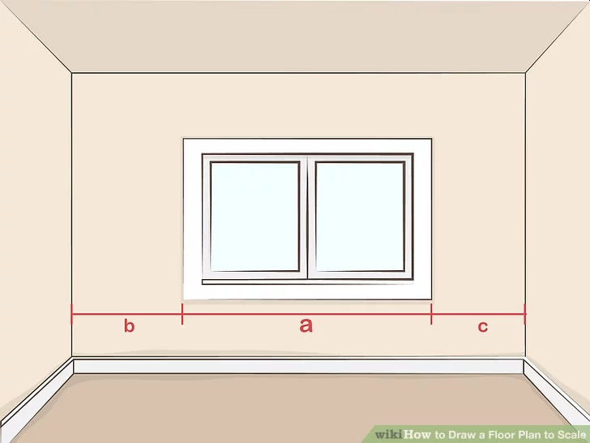
Scaled Drawing of Floor Plan
Measure all the doors and windows.
Measure the width of each door and window opening (without frames), and the distance from either side to the corners of the wall the window or door is on.
Then, convert these measurements to your chosen scale.
Example: A 3’ wide window will be represented by ¾” wide mark on your floor plan if you’re using a ¼” = 1’ scale.

Slide 64
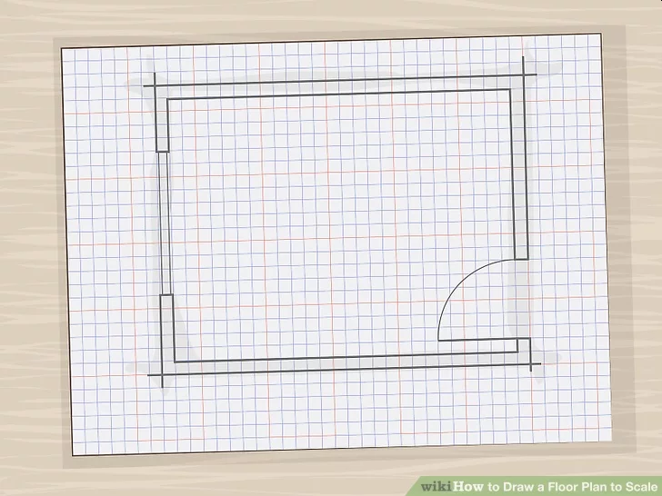
Scaled Drawing of Floor Plan
Incorporate the walls, windows, and doors into your floor plan.
Draw each window as a set of double lines and each door as a single line (i.e., the fully-opened door) with an arc (i.e., the actual swing path of the door).
Make sure you place each in the right position along the walls in your scale drawing.

Slide 65
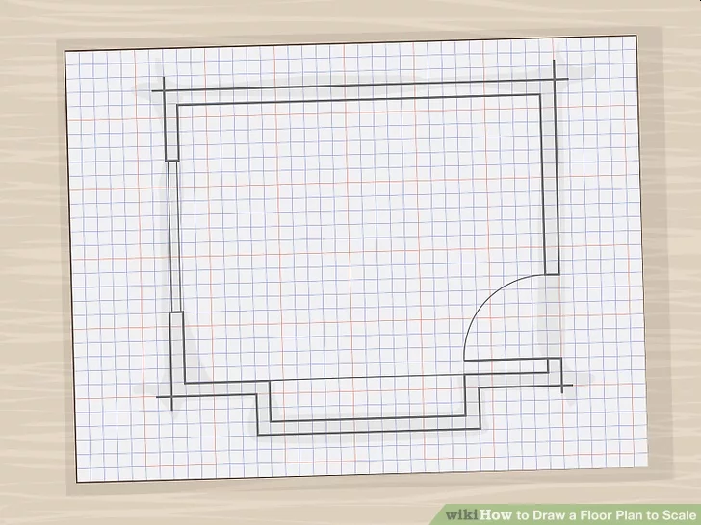
Scaled Drawing of Floor Plan
Measure and convert the widths of all built-in fixtures.
These include such items as counters and vanities, for example.
Convert them to scale, and add them to your plan in the appropriate locations.

Slide 66
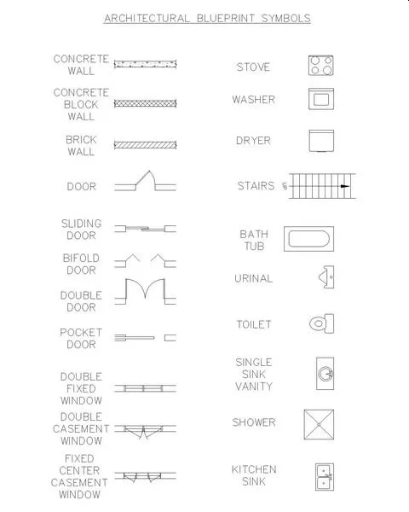
Scaled Drawing of Floor Plan
Common architectural symbols for windows, doors, counters, vanities, and other room elements

Slide 67
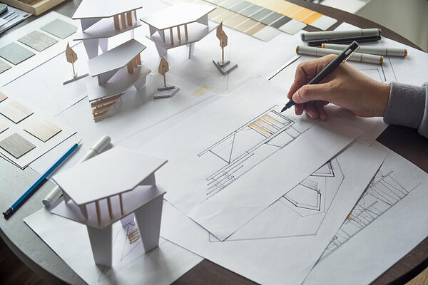
Requirement 5
Find out about three career opportunities in architecture. Pick one and find out the education, training, and experience required for this profession. Discuss this with your counselor, and explain why this profession might interest you.

Slide 68
Building Architects
Career, Salary and Education Information
What They Do: Building Architects are licensed professionals trained in the art and science of building design who develop the concepts for structures and turn those concepts into images and plans. Architects create the overall look of buildings and other structures, but the design of a building involves far more than its appearance.
What They Do: Building Architects are licensed professionals trained in the art and science of building design who develop the concepts for structures and turn those concepts into images and plans. Architects create the overall look of buildings and other structures.
Work Environment: Architects spend much of their time in offices, where they develop plans, meet with clients, and consult with engineers and other architects. They also visit construction sites to prepare initial drawings and review the progress of projects to ensure that clients’ objectives are met.
How to Become One: There are typically three main steps to becoming a licensed architect: completing a bachelor’s degree in architecture, gaining relevant experience through a paid internship, and passing the Architect Registration Examination.
Salary: The median annual wage for architects in 2020 is $80,750.
Job Outlook: Employment of architects is projected to grow 1 percent over the next ten years, slower than the average for all occupations. Improved building information modeling (BIM) software and measuring technology are expected to increase architects’ productivity, thereby limiting employment growth for these.

Slide 69
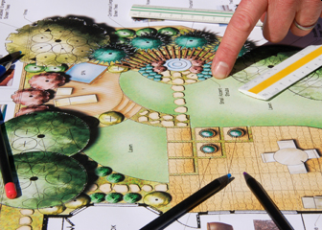
Landscape Architect
Career, Salary and Education Information
What They Do: Landscape architects design parks and other outdoor spaces.
Work Environment: Landscape architects spend much of their time in offices, where they create designs, prepare models, and meet with clients. They spend the rest of their time at jobsites.
How to Become One: All states require landscape architects to be licensed. Licensing requirements vary by state but usually include at least a bachelor’s degree in landscape architecture from an accredited school, internship experience, and passing the Landscape Architect Registration Examination.
Salary: The median annual wage for landscape architects is $69,360.
Job Outlook: Employment of landscape architects is projected to decline 2 percent over the next ten years. Improving technologies are expected to increase landscape architects’ productivity, which should reduce overall demand for the occupation over the next 10 years.

Slide 70
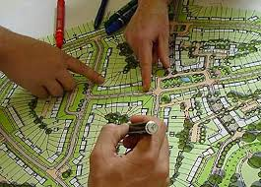
Urban Planner
Career, Salary and Education Information
What They Do: Urban and regional planners develop land use plans and programs that help create communities, accommodate population growth, and revitalize physical facilities.
Work Environment: Most urban and regional planners work full time during normal business hours, and some may work evenings or weekends to attend meetings with officials, planning commissions, and neighborhood groups.
How to Become One: Urban and regional planners need a master’s degree from an accredited planning program to qualify for most positions.
Salary: The median annual wage for urban and regional planners is $74,350.
Job Outlook: Employment of urban and regional planners is projected to grow 11 percent over the next ten years, much faster than the average for all occupations. Demographic, transportation, and environmental changes will drive employment growth for planners.

Slide 71
Historic Preservation Architect
What Does a Historic Preservation Architect Do?
A historic preservation architect helps preserve old buildings that have historical value.
Your duties in this career include making repairs and renovations that do not alter the interior or exterior appearance of the building.
You repair the structure, bring the building up to code, and take measures to ensure its longevity.
Your responsibilities usually involve making an initial assessment of the building and then working with historians, engineers, or other experts to create conservation plans.
In addition to safety and building code regulations, you also plan renovations that meet guidelines set out by organizations like the National Register of Historic Places.
How to Become a Historic Preservation Architect
The qualifications that you need to become a historic preservation architect include a degree, knowledge of architectural history, and planning skills.
Most employers prefer architects who have a master’s degree in architecture with a focus on historic preservation.
Some employers may accept an architect with a bachelor’s degree who has experience in historic preservation.
Most employers prefer applicants with previous experience in building restoration.
You also need experience using relevant computer programs, such as AutoCAD or another drafting software.

Slide 72
Historic Building Preservation

